Slide 1
Notes:
Hi Everyone,
Good Morning
Before we start with the presentation today, I would like to share a small recital.
We have been a part of Publicis Sapient for almost 3months now, and there is this fact that everyone of us would agree upon.
We all started as fresh graduates, underwent 5weeks or so of rigorous training followed by what…5 weeks now of a Hands On project, and what has transpired in these days is a fact that we all are really proud of. A transformation from someone who could code, to someone who can not only code, but add value to everything he does.
So have we succeeded at becoming a Product engineer?
Hi, I am Rajat, a small part of our big team here.
I am here with my colleagues Aman and Chinmay and we are here to give you a walkthrough of our Transformation, our Journey and the project we have been working for sometime now.

Slide 2
1
The Ask – Where we started?
…..

Slide 3
Objective of the Engagement
To build engineers and practitioners; inculcating the PE & SE Mindset, who understand technology & tools, engineering craft with leadership & delivery
Utilize them in Pods of 3-6
Problem needs ot be challenging with clarity of outcome
Visibility of backlog items
No Package only work
Setup
Work
Ability for work to be done autonomously
Should be client work (Ability to see value)
Full Stack work (No support)
Environment should be setup (DOJO access, cloud playground etc.)
Mentor / Buddy program
Engagement
High touch with constant feedback
Feedback & Governance
Accountability on Delivery Leads
Pulse check and Feedback on performance with Delivery Leads / Buddies
Meet a leader
Pulse checks and Feedback every Friday noon for first 6 weeks followed by Monthly

Slide 4
Framework for 3 Weeks
3 weeks plan

Slide 5
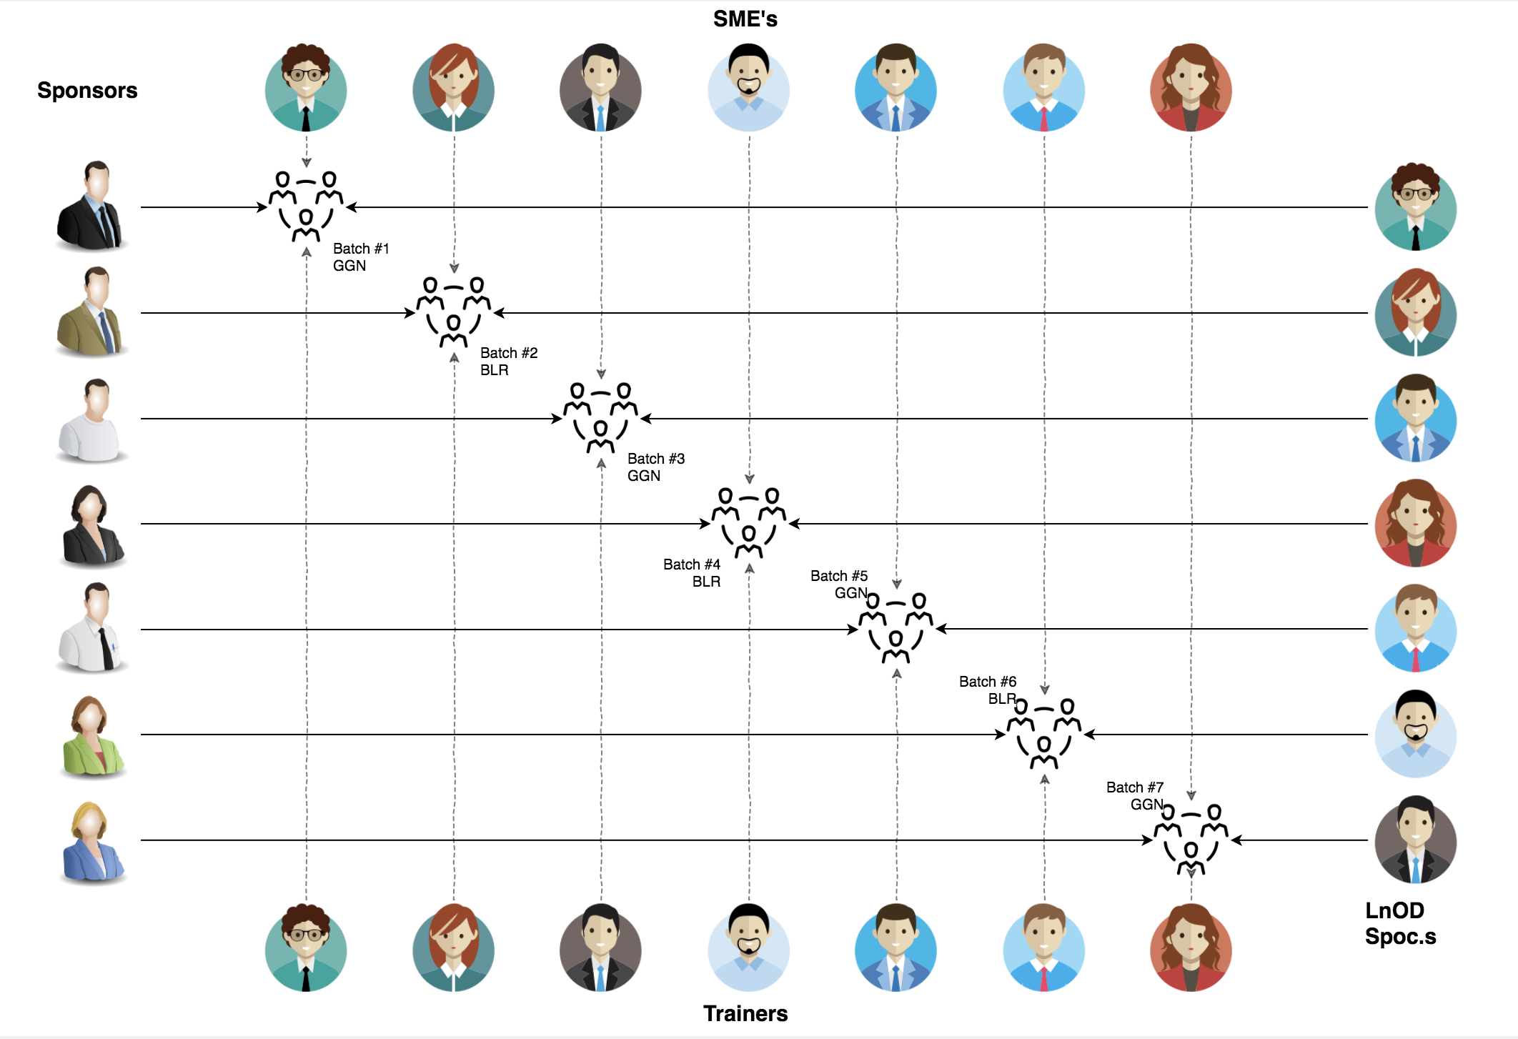
Stakeholders
Sponsors
Feedbacks
Thought Leadership
Case studies
SME’s
Practitioner views
Feedbacks
Sessions
LnOD Spoc’s
E2E co-ordination
Trainers
Train
Assess
Course-Corrections

Slide 6
Our next starts
NOW
Notes:
Time – 1 min
Swati

Slide 7
5 Weeks of Training + 7 Weeks of demo
60 DAYS
480 HOURS
28,800 MINUTES
1,728,000 SECONDS
Limitless knowledge

Slide 8

Agenda
01
Our Journey
02
Our Team
03
Team Structure
04
Project Goals
05
Engineering Practices
06
Tech Stack
07
Development
08
09
Challenges & Learnings
10
Demo
11
Questions
Notes:
Time – 1 min

Slide 9

Our Journey
Notes:
Time - 2 mins

Slide 10
Demo
Mindset
Process
5
Sprint Demo
Tools
4
Adapting to a developer
Mindset
Comprehend
3
Design Thinking
2
Project Management tools (Jira, Confluence)
1
Understanding Sprint Goals

Slide 11

Our Team
Notes:
Time – 2 mins

Slide 12

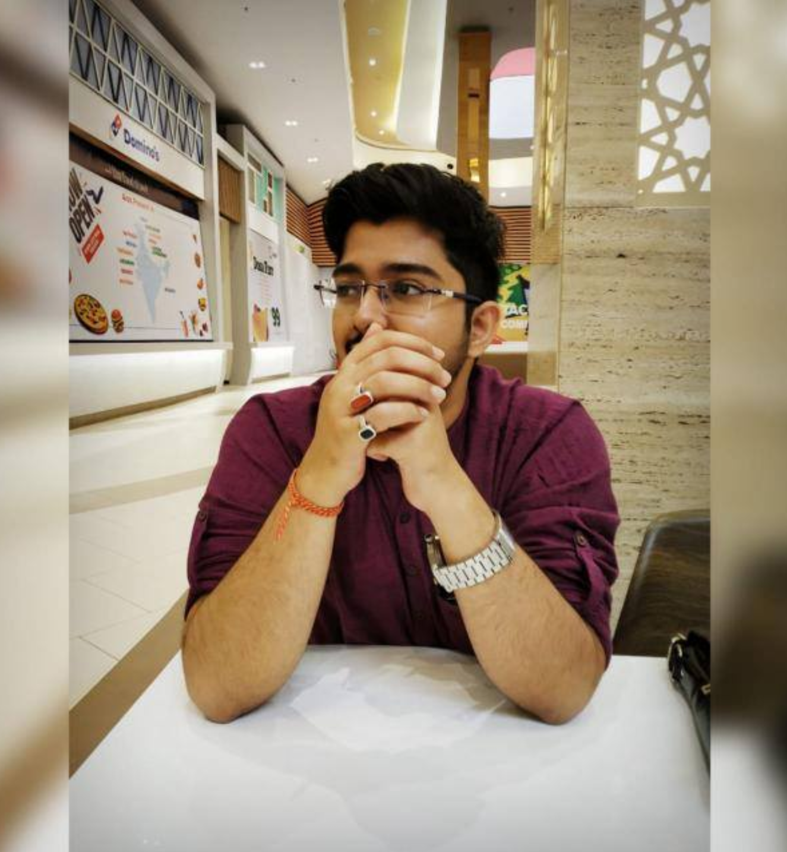

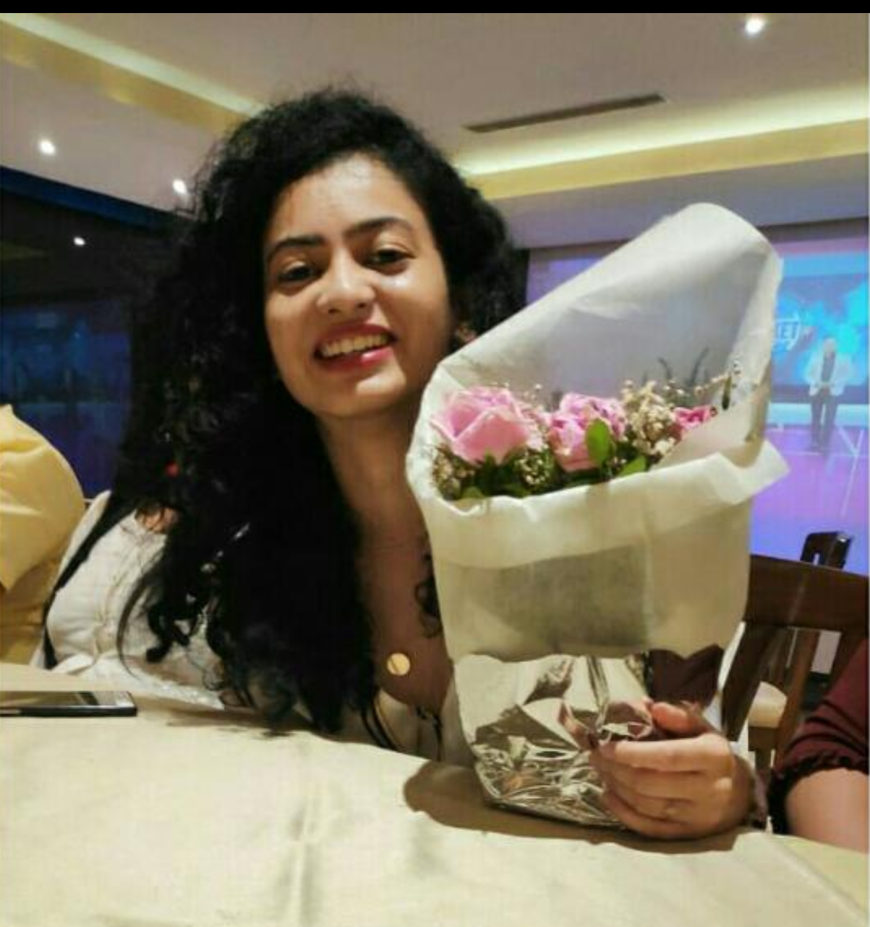
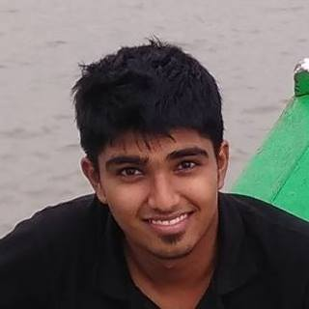
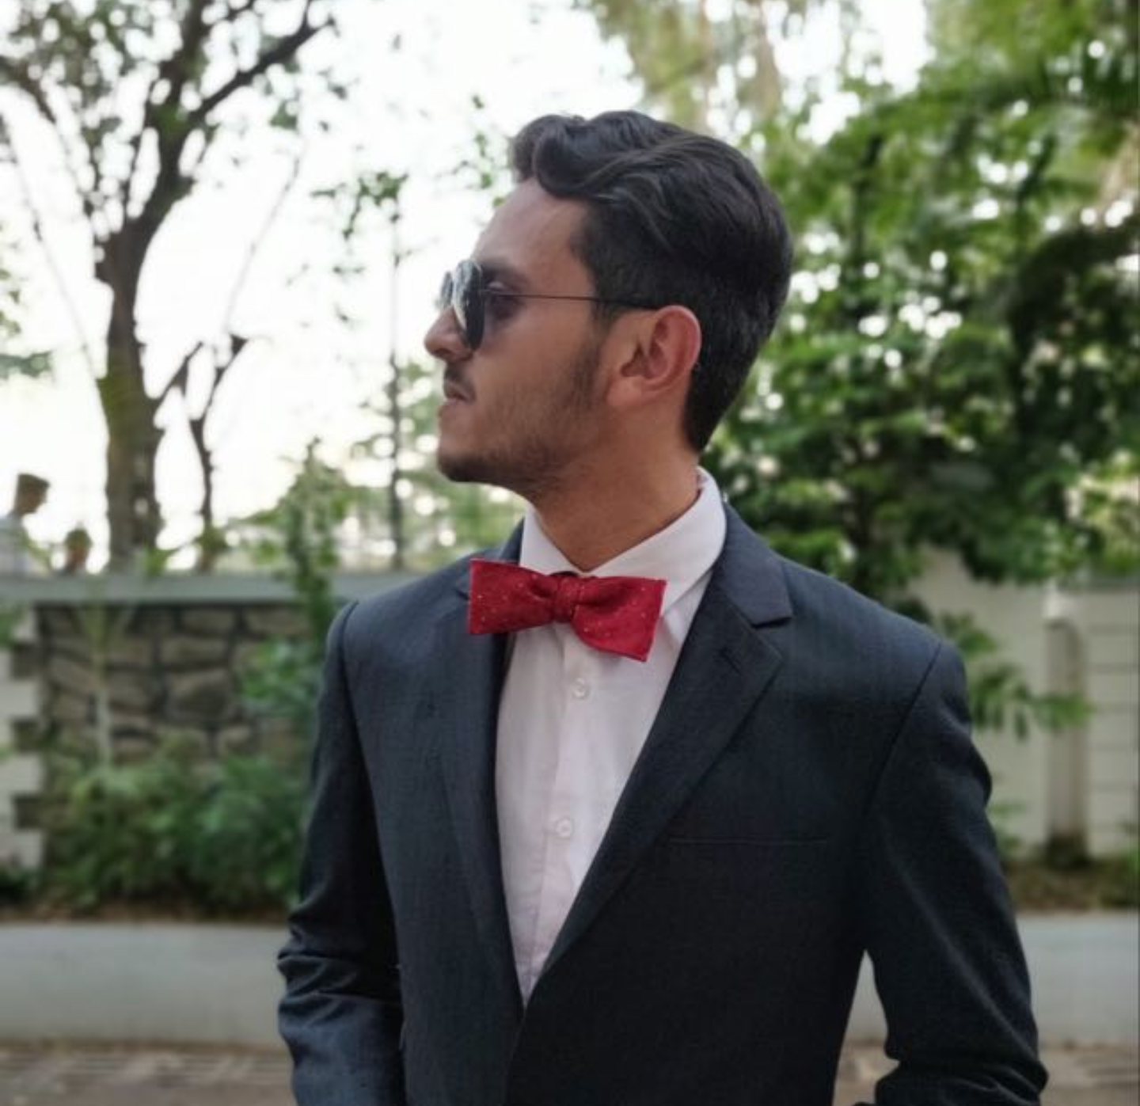
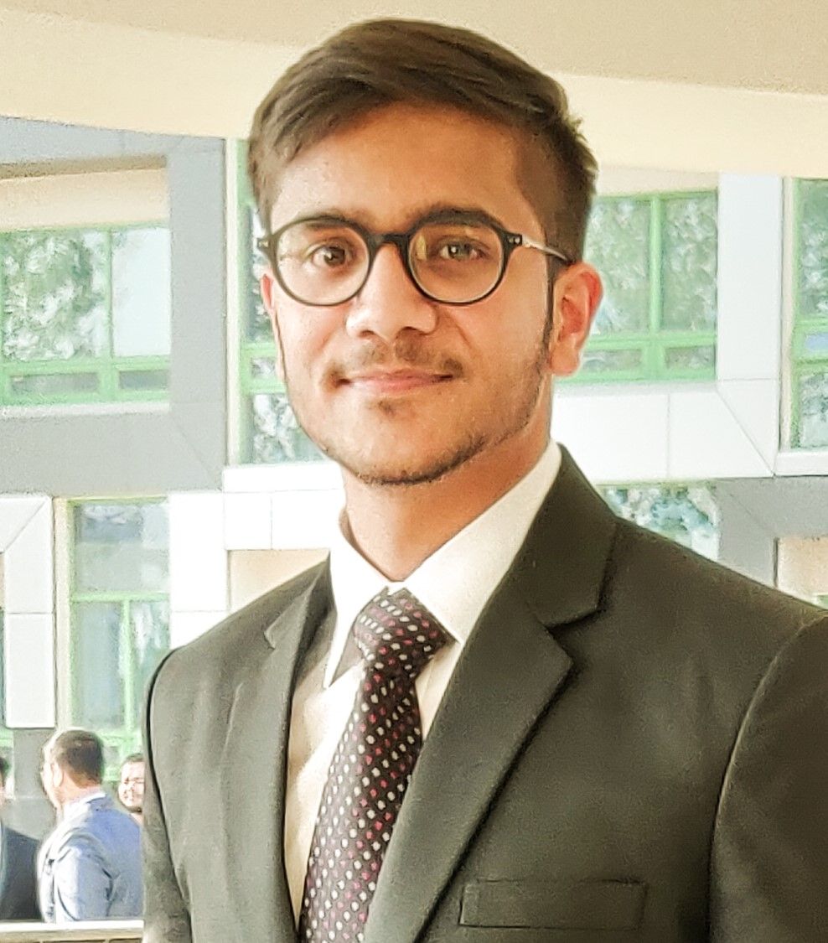
Abhishek
Dojo Boy
Arghadeep
Mr. Professional
Anirban
Nightingale
Ashana
React Mistress
Chaitanya
Rookie of the batch
Hasan
Camerawala
Kartikey
Owl of the batch
Kashish
Production Developer

Slide 13

Team Structure
Notes:
Time – 2 mins

Slide 14








Engineering Central Hub
Pod - 1
Pod - 2
Pod - 3
Pod - 4
Agile
Quality Engineering
DevOps
Engineering
Business Analytics
SME’s
Trainer
Scrum Master
Right Mix of Skills
Grgqt
Gq34tg
Qgf42gfqa.

Slide 15

Project Goals
Notes:
Time – 3 mins

Slide 16




Our Vision
To create an Order Management System using full stack development tools and technologies, where an agent as well as an customer scan place order from various products.
1
2
Quality
Security
3
4
Interactivity
Speed
Notes:
User satisfaction and brand value

Slide 17

Engineering Practices
Notes:
Time – 5 mins

Slide 18
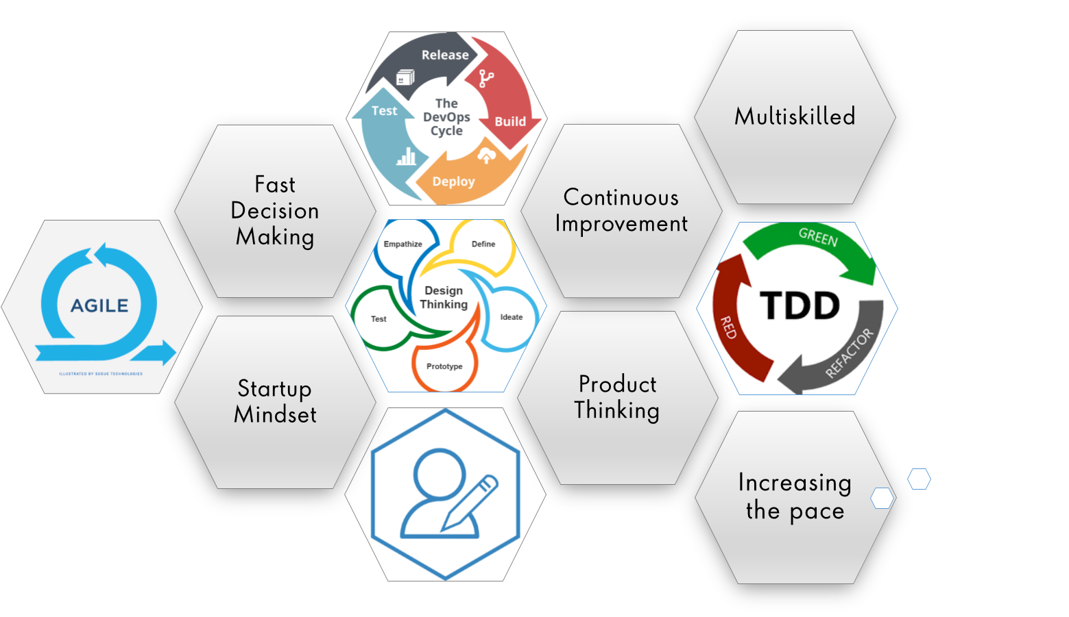
Notes:
Product Thinking (Design Thinking, Requirement Analysis, )
Multi Skilled (Frontend, Backend, DevOps)
Fast Decision Making (Agile)
Increasing the Pace (Automation CI/CD)
Startup Mindset (Agile)
Continuous Improvement (Retros)

Slide 19

Tech Stack
Notes:
Time – 2 mins

Slide 20






















Frontend
Backend
Infra
Data
Tools
Framework
Core Language
Automation Tool
NoSQL Database
Story Management
Framework
SQL Database
Documentation
Testing
Application Server
SCM
Testing
NFR Tools
NFR Tools
Notes:
Time – 1 min

Slide 21

Development
Notes:
Time – 1 min

Slide 22
Sprint Planning
Spring Grooming
Requirement understanding
Sprint Implementation
LLD
Delivery
Integrate
Research and analysis
Estimation
Test Cases
Development
Code Review
Pipeline Build
Commit
Deploy
Test
Notes:
Time – 1 min

Slide 23

NFRs
Notes:
Time – 2 mins

Slide 24

Challenges & Learnings
Notes:
Time – 2 mins

Slide 25





Challenges & Learnings
1
2
3
4
5
Mindset
Estimation
Communication
Management
Leadership
Change from Coding Mindset to
Product Engineering Mindset
No idea about estimation to better estimation of tasks.
Silence in the room to daily individual & team discussions.
From spill overs to finishing the tasks on time and logging them.
From managing ourselves to managing the whole team.
Notes:
User satisfaction and brand value

Slide 26

Demo
Notes:
Time –
Architecture – 5 mins
NFR Dashboard – 3 mins
Demo – 10 mins
1. Show the Responsiveness and Wave tool first

Slide 27

Questions
Notes:
Time - ?

Slide 28
Thank you
Notes:
Time – After this show the testimonial video. 1 min

Slide 29
Requirement understanding
Research and analysis
Estimation
Grooming
LLD
Test Cases
Development
Code Review
Pipeline Build
Commit
Implementation
Delivery
Integrate
Deploy
Test
Notes:
Time – 1 min

Slide 30
Frontend
Backend
Data
Tools
Notes:
Time – 1 min

